Slide 1
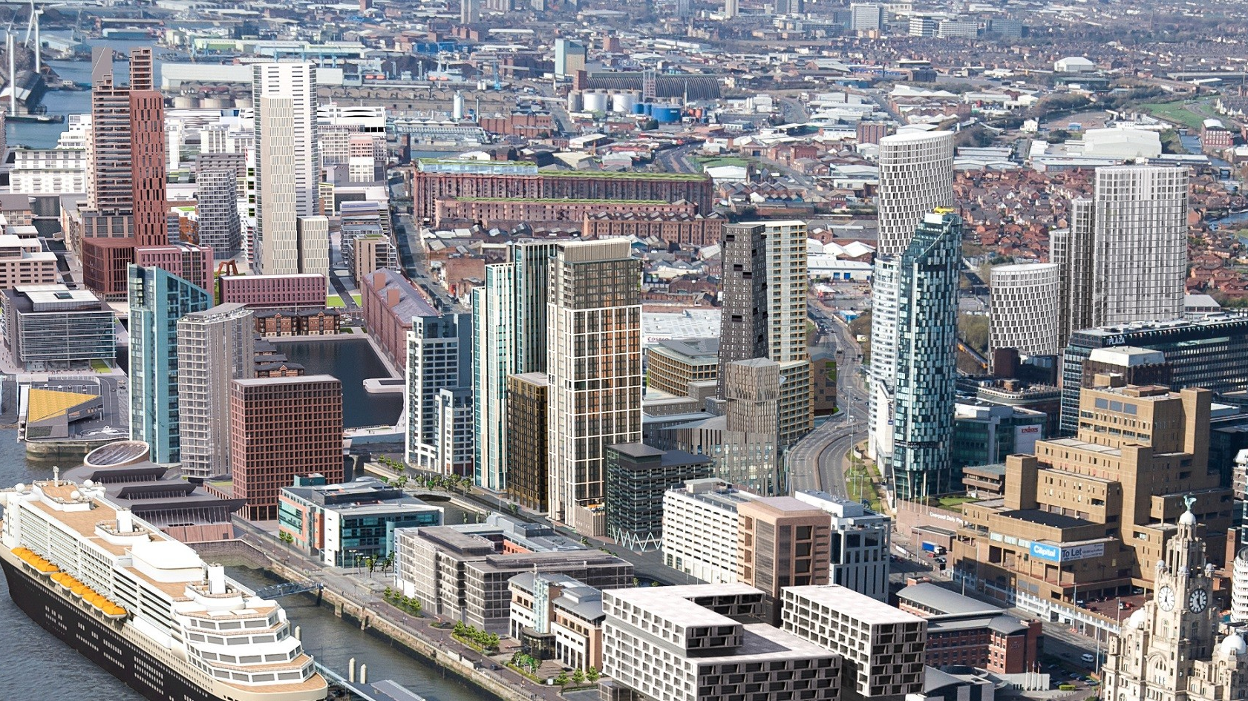
Liverpool
Šárka Mottlová

Slide 2
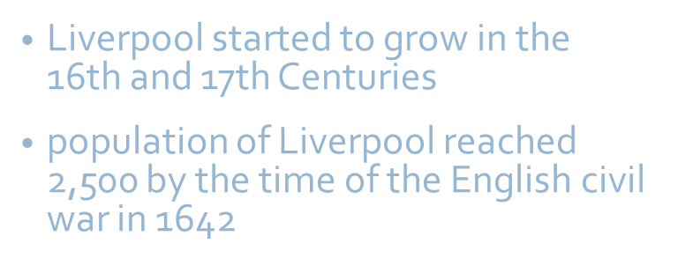
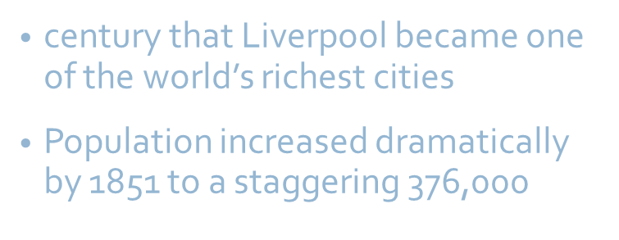
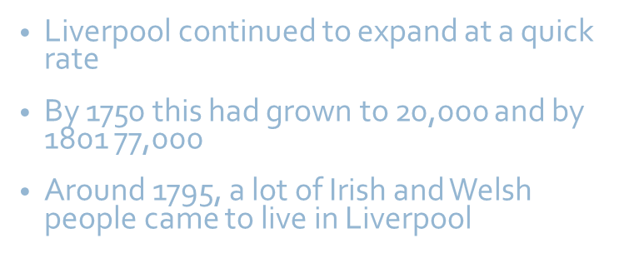
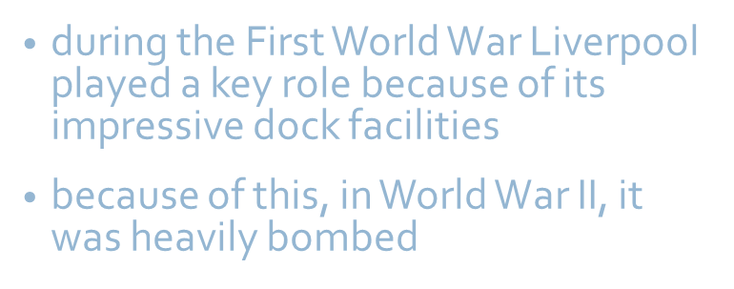

Slide 3
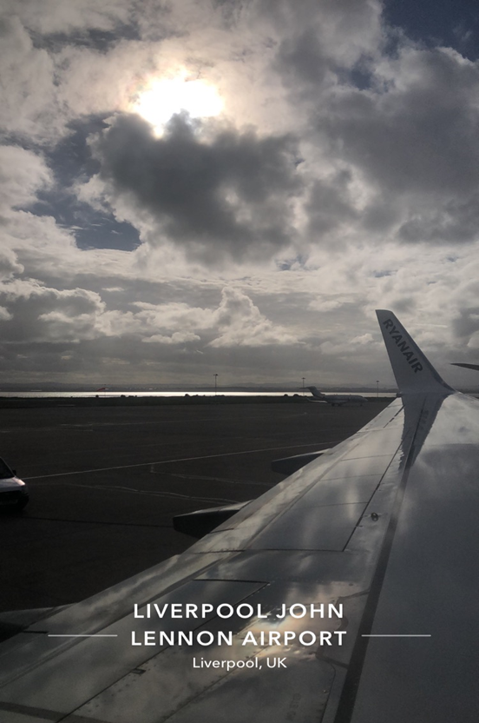
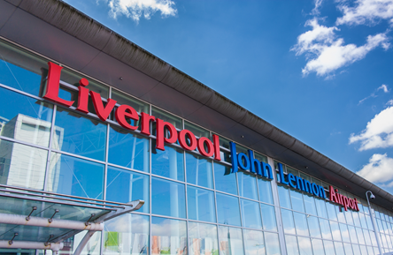
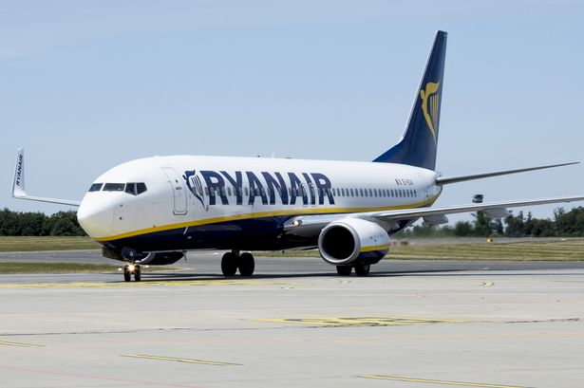
1.10.2018

Slide 4
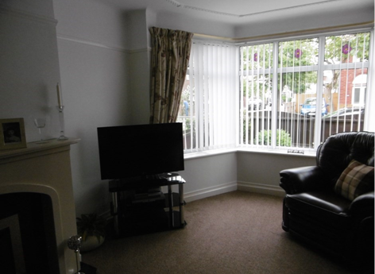
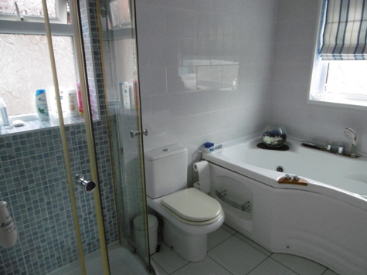
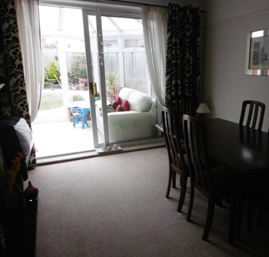
Family

Slide 5
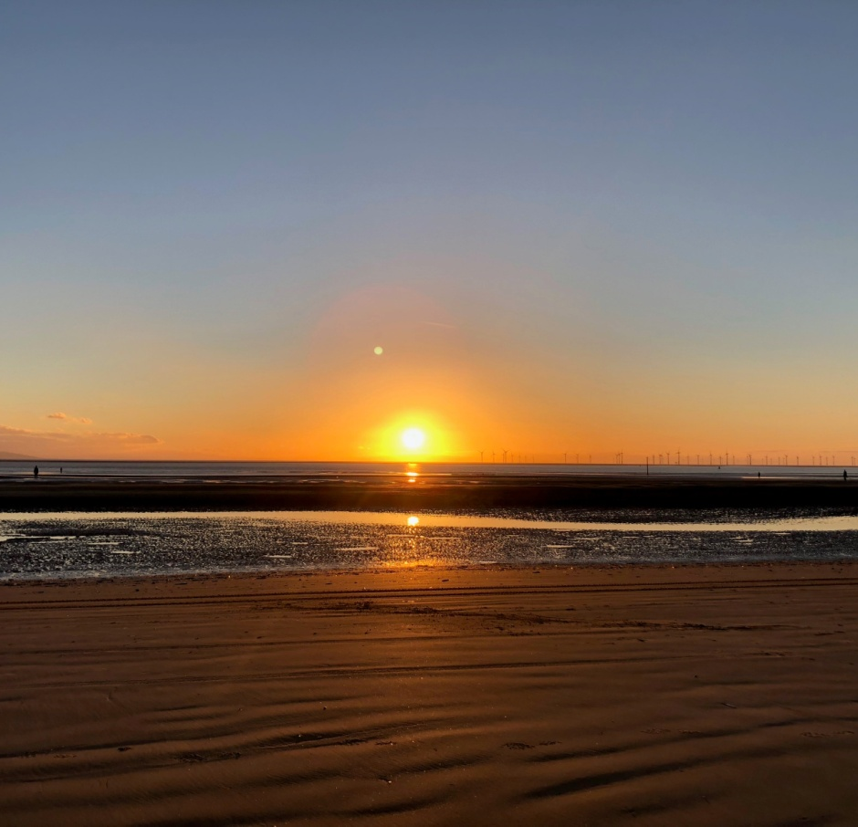
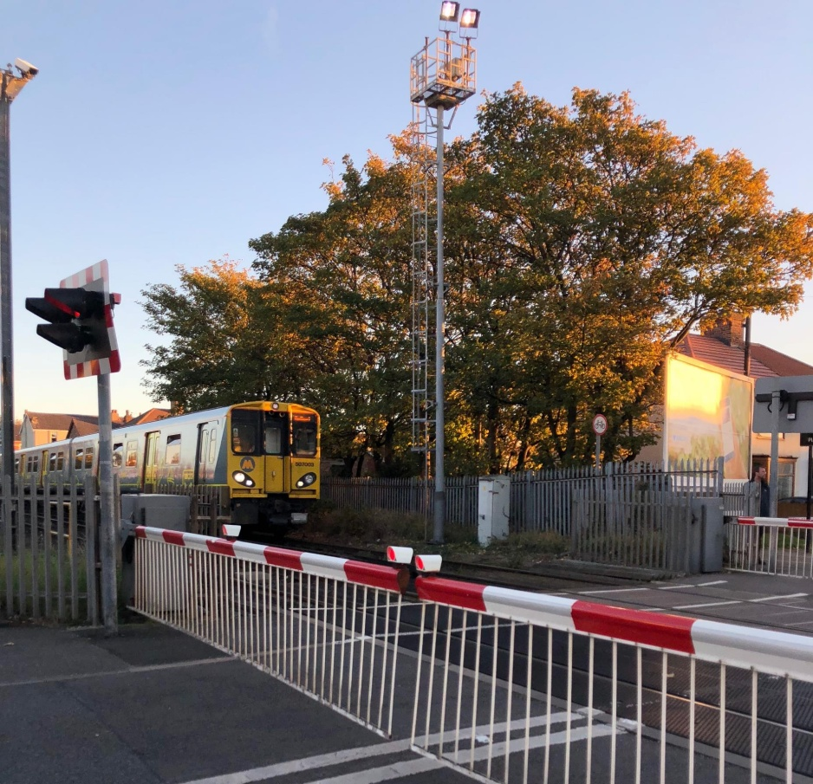
Blundellsands and Crosby

Slide 6
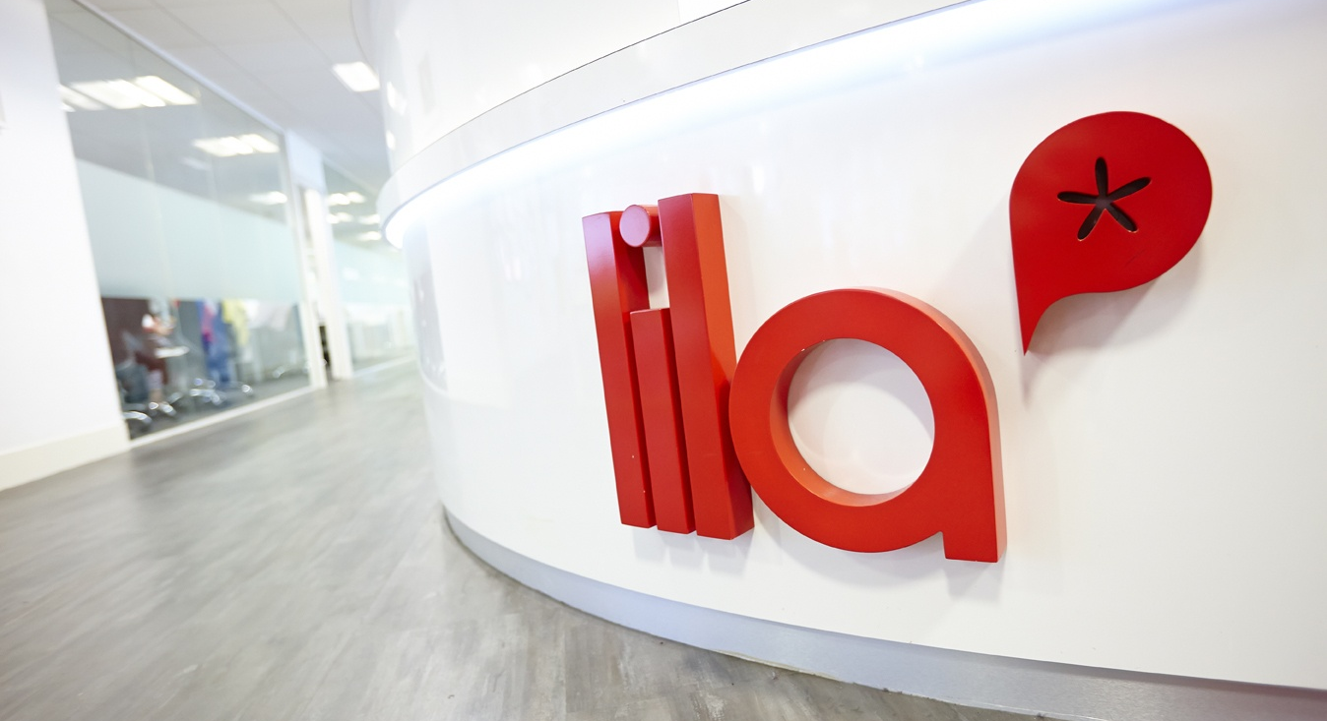
School
1 school hour took 1:30 hour
Classes divided into English levels
Students from different nations
12 students in 1 class
Under 18 program
Common room
End of the week revision test
https://youtu.be/G8blJUoxpzQ

Slide 7
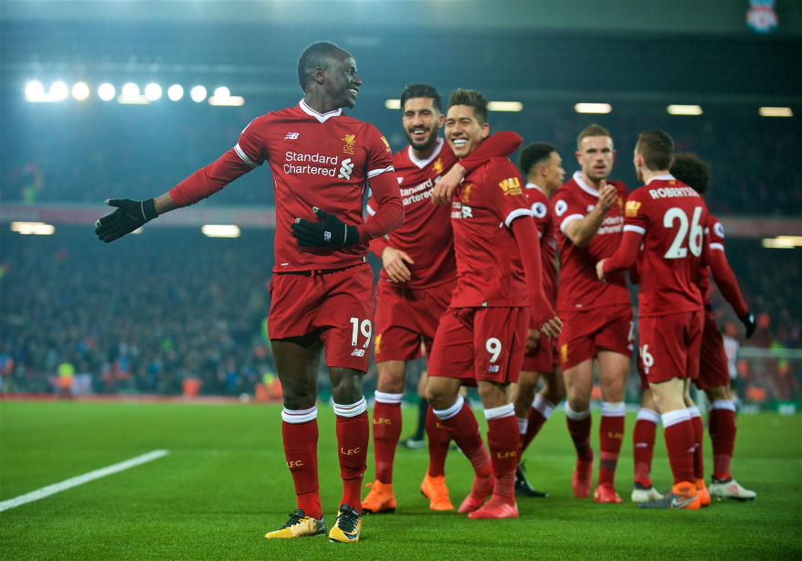
Liverpool FC
professional football club in Liverpool
top tier of English football
Founded in 1892, the club joined the Football League
Stadion - Anfield
long-standing rivalries with Manchester United and Everton
3 czech players – Patrik Berger, Vladimír Šmicer, Milan Baroš

Slide 8
Liverpool centre

Slide 9
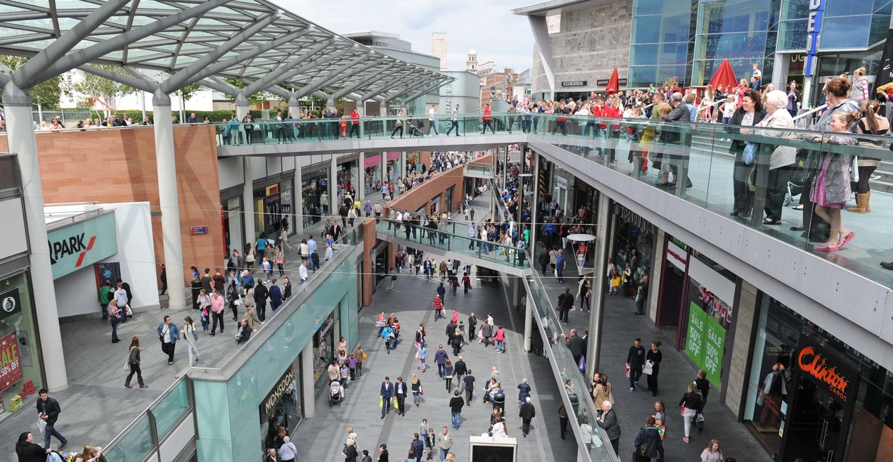
City centre

Slide 10
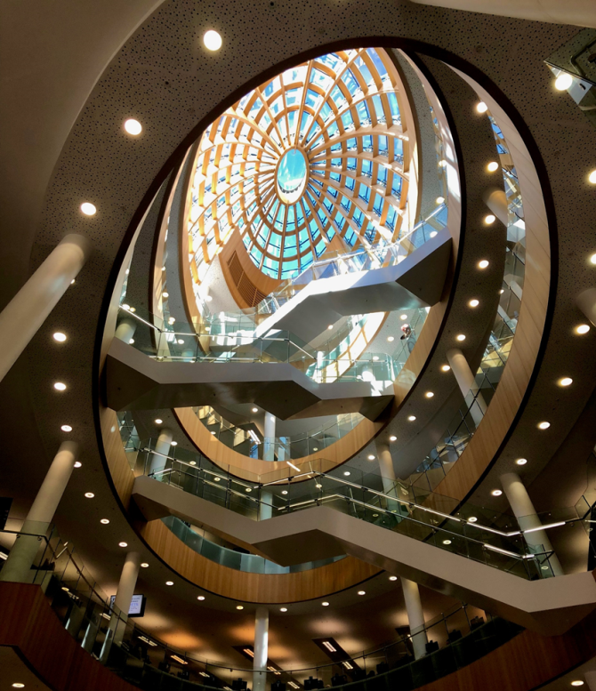
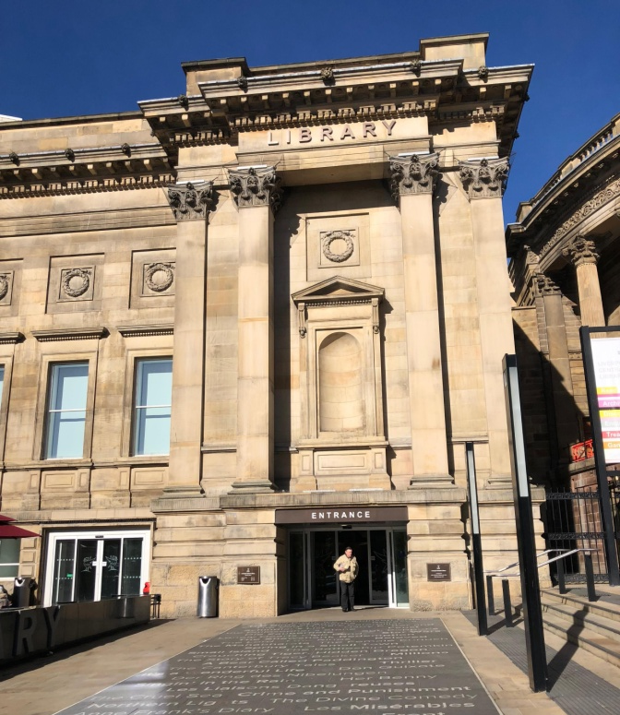
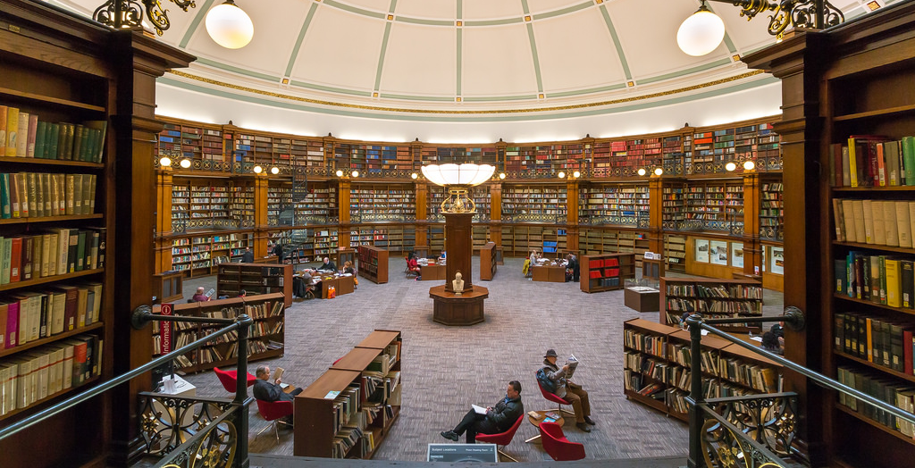
Central Library

Slide 11
Beatles statue
https://www.youtube.com/watch?v=xqi6wQNCOMk

Slide 12
China town

Slide 13
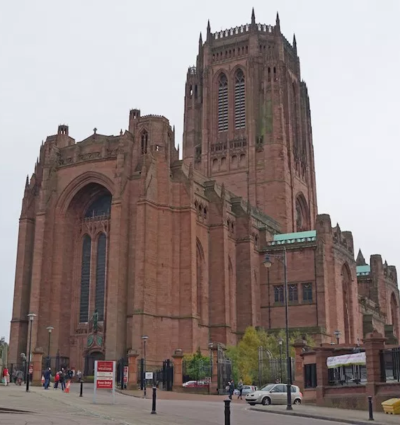
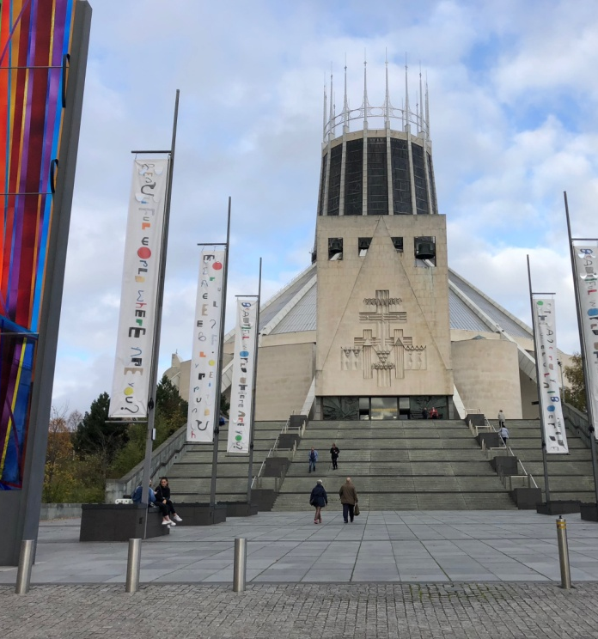
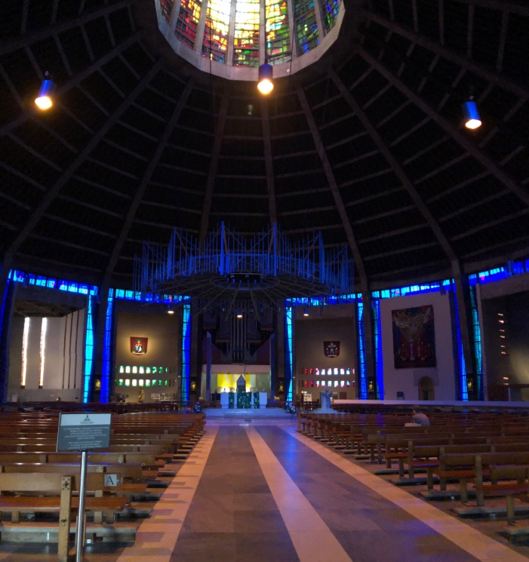
Cathedrals
Cathedral Church of Christ in Liverpool
Liverpool Metropolitan Cathedral

Slide 14
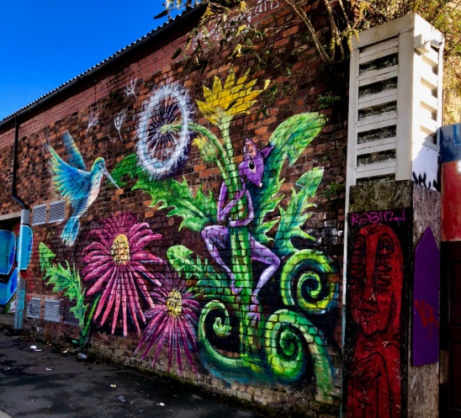
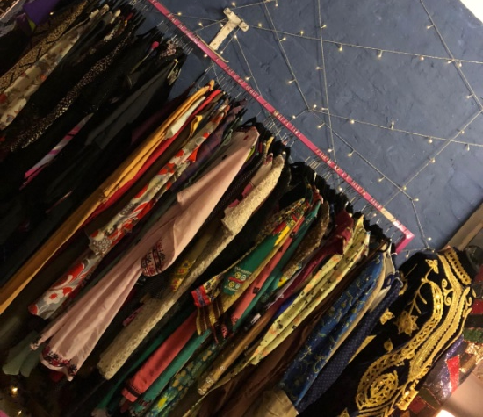
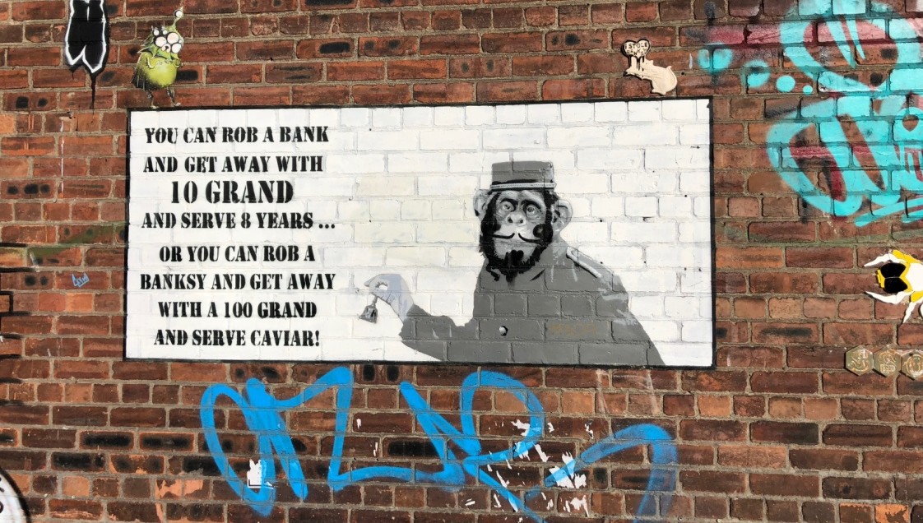
Markets

Slide 15
thank you for your attention

